Slide 1

World Bank tools for revenue performance analysis and benchmarking, and revenue projections and simulations
October 2019
1

Slide 2
Outline
Tool for Revenue Performance Analysis and Benchmarking
Tools for Revenue Projections and Simulations
1
2

Slide 3
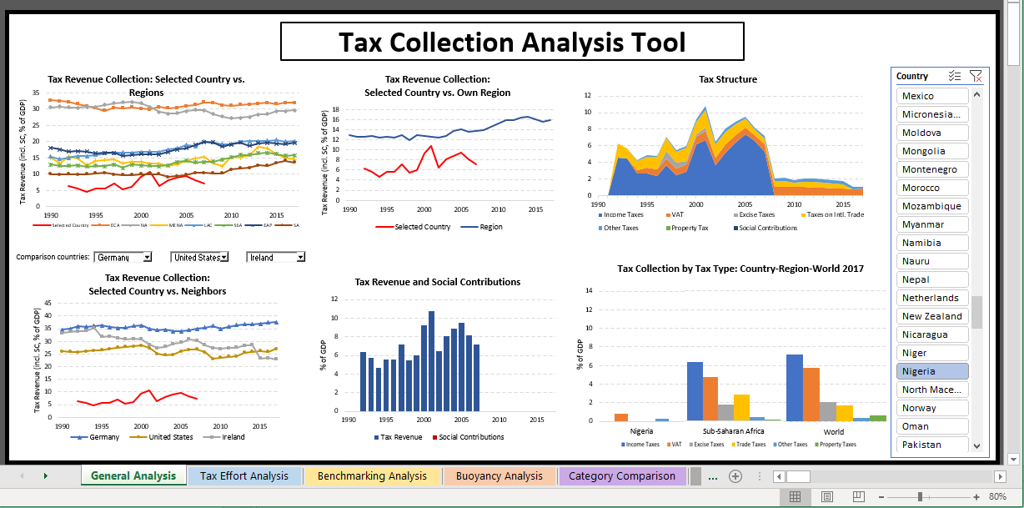
1) Revenue Performance Analysis and Benchmarking (New WB tool)
Xls-based tool, developed by the World Bank, using publicly available international tax data sources
Nigeria data is missing/inaccurate -> Data needed: reconciled historical tax and non-tax revenues

Slide 4
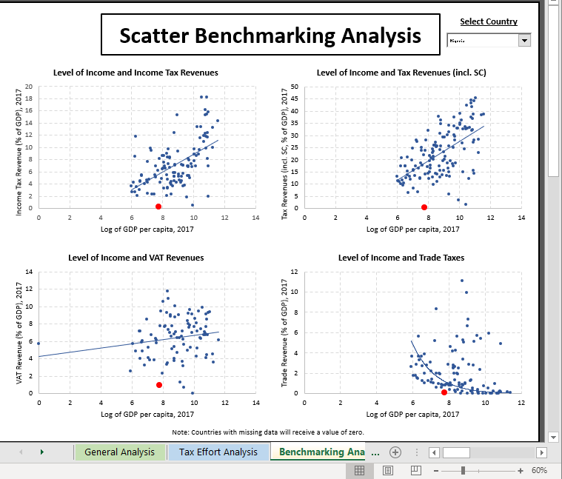
1) Revenue Performance Analysis and Benchmarking (New WB tool)

Slide 5
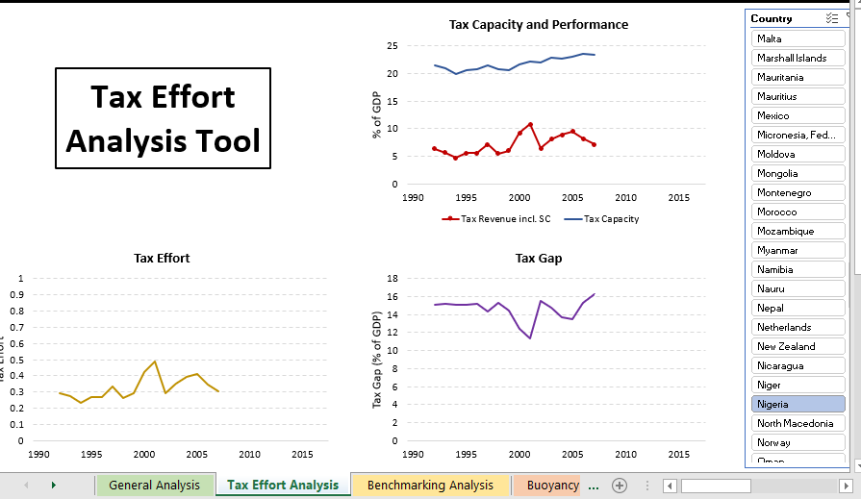
1) Revenue Performance Analysis and Benchmarking (New WB tool)
Tax capacity refers to the predicted tax-to-gross domestic product ratio that can be estimated empirically, taking into account a country's specific macroeconomic, demographic, and institutional features, which all change through time.
Tax effort is defined as an index of the ratio between the share of the actual tax collection in gross domestic product and taxable capacity.
The difference between the revenue potential (legal) and actual revenue collected is commonly understood as the "tax gap."

Slide 6
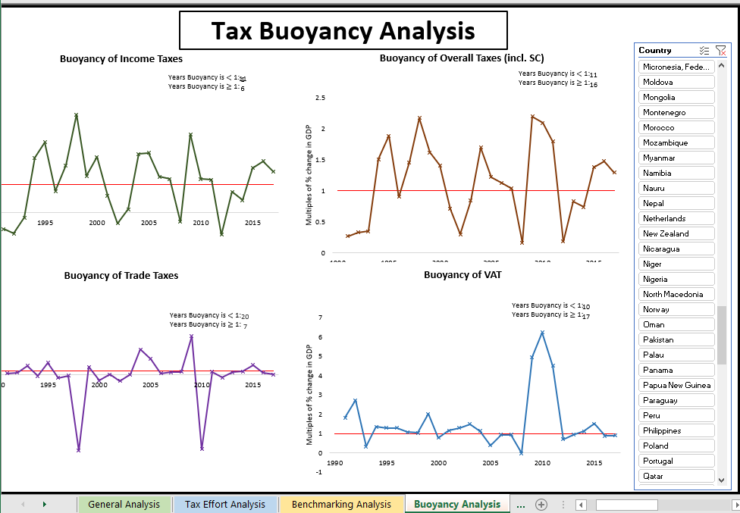
1) Revenue Performance Analysis and Benchmarking (New WB tool)

Slide 7
Outline
Tool for Revenue Performance Analysis and Benchmarking
Tools for Revenue Forecasting/Projections and Simulations
1
2

Slide 8
Non-oil Revenue Microsimulation Models and Data requirements: VAT
Value Added Tax Revenue Forecast Model – Two Methodologies
CURRENT Method: Aggregate or National Accounts Approach
Starting point VAT base estimated by private sector domestic consumption. If provision for input tax credit for capital investment, reduce by the amount of fixed gross capital formation. VAT base x VAT rate = potential VAT.
Obtain C-efficiency by comparing potential VAT with actual collection.
Project based on growth estimates of components of GDP, VAT rate and c-efficiency assumptions
POTENTIAL METHOD: Disaggregate or Input - Output Approach
Start with: Domestic consumption expenditure by households on goods & services (remove embedded taxes)
Subtract: - Zero-rated goods and services
- Exempt goods and services
Add: - New residential construction - Intermediate goods of exempt business activities
Project based on growth rates of consumption by households and sector, and exports and imports.
This approach provides a useful tool for quantifying revenue implications of various tax policy measures. Also, it can be used to analyze the VAT gap, or the tax incidence
Information needed:
VAT collection data (gross and by sector, including import VAT)
Exemptions, zero-rating, special treatment of products/services (reverse charge, etc.)
Input-Output tables
VAT returns data (to estimate effective rates by I-O commodity categories)

Slide 9
Non-oil Revenue Microsimulation Models and Data requirements: PIT and CIT
POTENTIAL Income Tax Revenue Forecast Models
1. PIT:
Model based on annual income tax returns, supplemented by surveys to cover non-filers.
A typical model calculates the tax liability of a typical individual taxpayer (student, elderly person, couple with children, single person, or disabled person) or family.
Typical taxpayer model follows the logic used to fill out the tax returns to calculate the income tax liability.
For revenue forecasts, a sample of taxpayers and their tax liability is created using a sampling process and revenues are forecast based on expected growth rate of population, different streams of income etc.
Information needed:
Income tax returns data (can be anonymized);
Household surveys;
Data on macro indicators, e.g., population growth rates, wage growth trends, investment income trends, etc.
2. CIT
Corporate Income Tax (CIT): A similar approach may be applied but the CIT forecasting model is more complicated due to provisions such as loss carry forward and accelerated depreciation, incentives such as tax holidays, etc.
In addition to forecasts, this model simulates the impact of proposed policy changes on the tax liability of the taxpayer.

